Slide 1

Cumberland County Board of Directors
What’s Your Charge
Smart Start Orientation
Notes:
This presentation provides a refresher and some resources related to your roles and responsibilities as a Smart Start Board Member. Given the timing, let's get started!

Slide 2
What is Smart Start?
Smart Start Vision:
Advance a high quality, comprehensive, accountable system of care and education for each child beginning with a healthy birth.
The Smart Start Network:
75 Independent, nonprofit organizations serving all 100 NC Counties. Smart Start was designed to give communities local control to determine the best approach to achieving outcomes for children and families.
Notes:
“You can see here that the Vision for Smart Start is to have a strong Early Childhood System across the state that leverages state money to ensure young children have a strong start.”
“The uniqueness of how Governor Hunt designed Smart Start is what we call the network: 75 independent nonprofits serving all 100 counties with local control to determine the needs of their specific community, but a larger network of agencies that do similar work across the state! We are seen as a strong nationally recognized network because of this.“
“NCPC’s role is to make sure of the integrity of the programs and services that are provided using Smart Start funds and be accountable for the stewardship of public funds across the state”
“It can be awkward at times for NCPC because we wear the hat of both funder and supporter. We have a desire to provide guidance and support the work at the local level throughout the state but also have the accountability arm and have a need to monitor spending per legislative guidelines.”

Slide 3
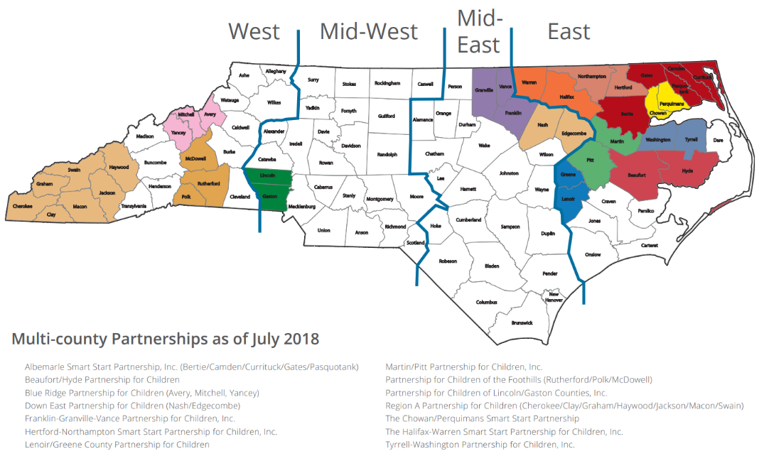
North Carolina Smart Start Network
Notes:
“This is the image of the Smart Start Network that almost every staff member at NCPC has in their office as it's used all the time.” Point out their county.
“You'll notice that some counties have combined into what we call multi-county partnerships, so their smart start efforts spread across county lines while all 100 counties of the state are still being served. Those counties are what you'll see in color on this map."
“In the Smart Start legislation, an advisory committee structure was created which is what we call LPAC—Local Partnership Advisory Committee—LPAC has board chairs and EDs from each of the Smart Start regions- West, Mid-West, Mid-East and East that come together regularly to provide a feedback loop from the regions to NCPC and back.”

Slide 4
Smart Start Network Leadership
Local Partnership Advisory Committee (LPAC)
North Carolina Partnership for Children (NCPC)
Provides both accountability measures and technical assistance to local partnerships.
NCPC Board of Directors
Appointed by elected officials or by virtue of their position, this board oversees NCPC’s administration and implementation of Smart Start funds.
Local Partnership Board of Directors
Governs the local partnership by overseeing the administration and implementation of organizational vision and policy.
Local Partnership Executive Director
Provides the day-to-day management of the organization to ensure it meets its vision.
Notes:
Your board is a member of one of the 76 boards of directors leading Smart Start across the state. This slide shows the continuum of leadership across the Smart Start Network.
The NCPC Board of Directors oversees NCPC’s administration and implementation of the Smart Start Legislation and organizational operations, while the staff at NCPC are charge with maintaining accountability for Smart Start funds and supporting the Network of 75 Smart Start Local Partnerships.
As a Local partnership board member, you are responsible for overseeing the administration and implementation of organizational vision and policy
The Local Partnership ED’s are responsible for the day-to-day management of the organization.
The LPAC helps communicate information back and forth across these 4 groups of Smart Start leaders keeping abreast of the needs of the entire state network.

Slide 5
Ten Board Governance Responsibilities
Determine mission & vision
Select an Executive Director (ED)
Support and evaluate the ED
Ensure effective strategic planning
Monitor and strengthen programs & services
Build a competent board of directors
Ensure financial resources
Protect assets and provide financial oversight
Ensure legal and ethical integrity
Enhance the organization’s public standing
Notes:
Board Source provides wonderful resources for nonprofit board members and offers guidance on best practices for board governance and leadership. They outline the 10 responsibilities of Nonprofit board which are shared on this slide.
The board takes the lead, for example, when it:
Articulates the guiding values of the organization through policies that put the organization's mission & vision into action;
Hires, supports, and evaluates the executive director;
Ensures there’s a robust, community needs driven strategic plan is in place and monitored and updated regularly
Monitors fiscal management, approves the annual budget, and assures that there is an annual audit; and
Selects, recruits, and orients new board members.
• Ensures 100% board giving and Opens the doors to fundraising in the community;
• The board chair and executive director share the lead when they
• Establish board meeting agendas;
Ensure legal and ethical integrity for the organization
• Represent the organization in the community
Share link to “10 Responsibilities” Handout
https://boardsource.org/wp-content/uploads/2017/07/Additional-Resources-10-Basics.pdf?hsCtaTracking=cb50c3da-ace0-4835-9d22-00e25b52a131%7Ce0bfbf95-c960-4e91-b288-65be66578cd5

Slide 6
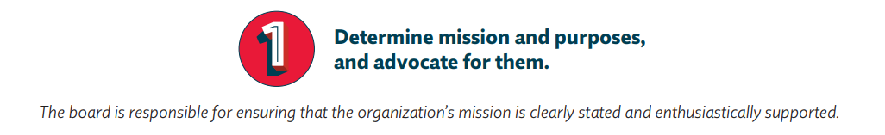
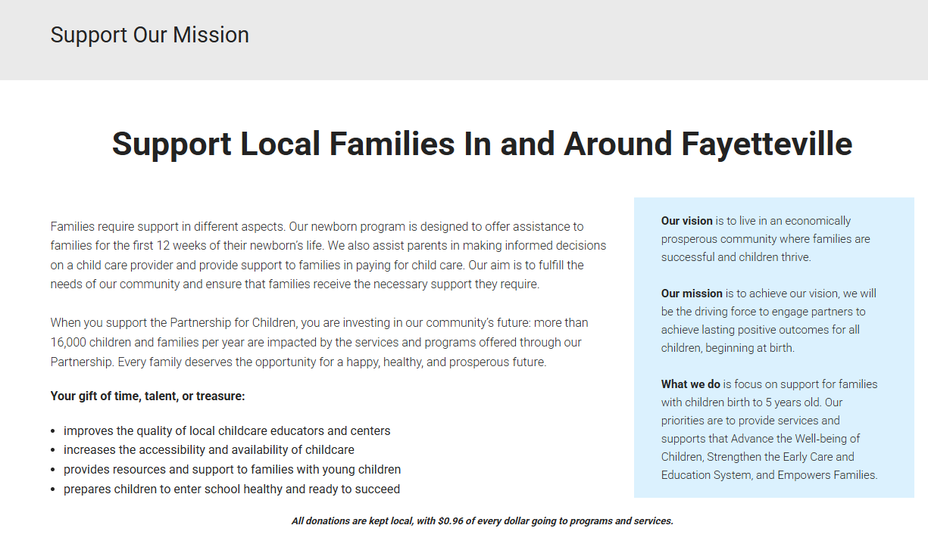
Notes:
First, the Board of Directors is responsible for determining the mission and purpose of the organization. Partnership for Children Cumberland County vision and mission:
The vision is to live in an economically prosperous community where families are successful, and children thrive.
The mission is to achieve our vision, we will be the driving force to engage partners to achieve lasting positive outcomes for all children, beginning at birth.

Slide 7
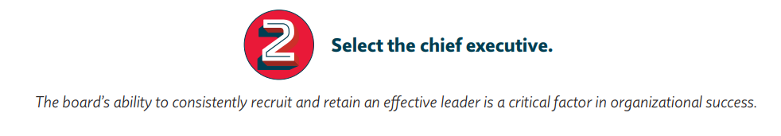
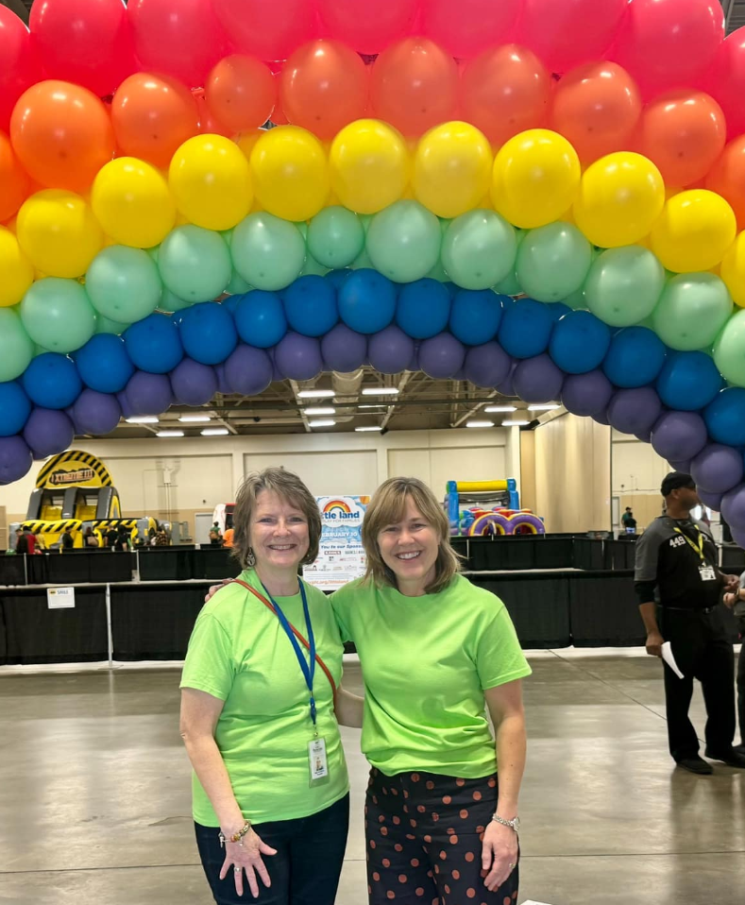
Notes:
The 2nd responsibility is to select a chief executive
Executive succession planning is a structured process to ensure leadership continuity in key positions and to retain and develop knowledge capital and relationships for the future
Effective succession planning increases the likelihood that a nonprofit will have the strong leadership required to increase an organization’s service capacity, program effectiveness, and long-term stability and sustainability
Succession planning can take on different forms and be completed for various situations.
We have a complete succession planning toolkit in LP Central that will be helpful in this work.
Three scenarios, in particular, are recommended for all organizations, and are defined in this toolkit:
• Emergency Succession Planning – A process that is in place in the event the executive suddenly departs – either permanently or for an extended period of time (i.e., longer than
three months).
• Departure-Defined Succession Planning – A process that is in place for a future planned retirement or permanent departure of the executive.
• Strategic Leader Development – A process that promotes ongoing leadership development for talent within the organization.

Slide 8
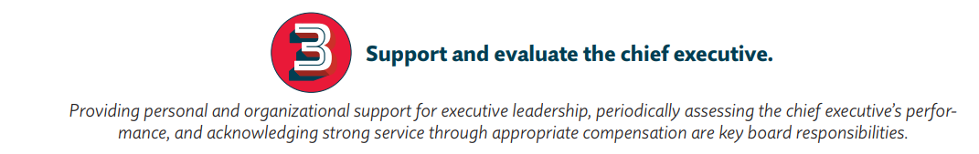
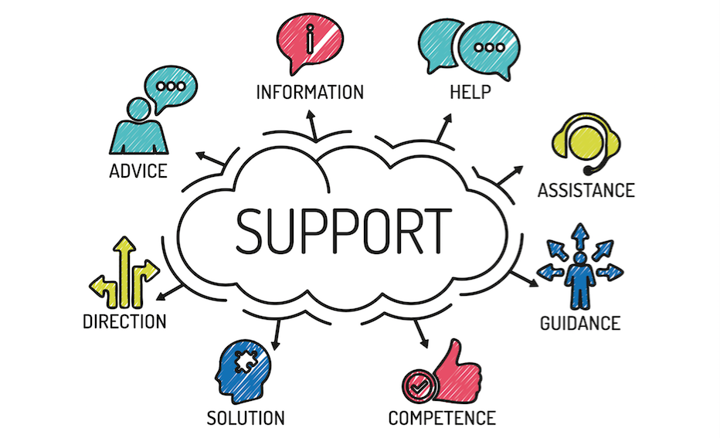
Notes:
As the board, it is your responsibility to support and evaluate the ED in their role leading the organization day to day.
The board is responsible for doing a comprehensive evaluation of their ED on an annual basis. This is best practice for any organization, and is important for your ED’s professional growth, development, and success.
The primary purpose of performance reviews is to help the ED perform more effectively, with healthy and constructive feedback. NCPC can be a resource for providing support in best practices around ED evaluations.

Slide 9
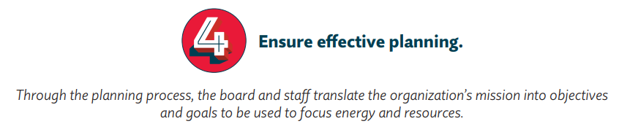
Engage in a community needs assessment.
Use data to drive decisions
Engage stakeholders
Notes:
The next key responsibility of a Board member is to ensure the organization has a strategic plan is in place. As you may know, assessing the community, using data, and engaging stakeholder input in the process, ensures that you have an effective strategic plan. The strategic plan is not a static document and is meant to be used as a tool throughout its designated timeframe.
The strategic plan should guide the work that the organization is doing. Programing and fund-raising efforts should be aligned with the goals of the strategic plan. NCPC can offer you support through the strategic planning process as needed.
Prompting Questions:
When is the last time you engaged in a strategic planning process?
Who is responsible for setting the long-term strategic plan for the organization?
Some steps to consider for your SP:
1. Convene a group of community stakeholders. – It’s beneficial in the strategic planning process to get external and internal feedback around your strategic planning process. Such as from groups that represents the communities you are serving.
Ex. Program staff, funders, families accessing services, community members, partner organizations, community coalitions, faith leaders, youth leaders, local government, chamber of commerce, board members, etc.
2. Identify Community Strengths and Needs- Often the focus goes to where the need lies, and this is important, but evaluating community strengths and needs can also set you up to leverage what is working well and build on the existing strengths and assets that exist in your community.
How will you gather this information?
Ideas: focus groups, surveys, partnering with other organizations collecting similar data, working with a consultant or research group, reviewing current programmatic outcome data, etc.
3. Review and Confirm the Mission, Values and Vision- The strategic plan should clearly identify your lane and help you stay there. If new funding opportunities or initiatives come along, your plan should be able to help you decide what might be a good fit in terms of taking on new programs or funding streams.
4. Develop Goals, Outcomes and Action Steps
5. Analyze SWOT, community feedback, data, and current program outcomes
6. Write the Plan
7. Implement the Plan
8. Monitor and Track Progress
9. Evaluate and/or revise the plan

Slide 10
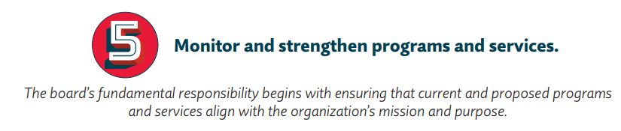

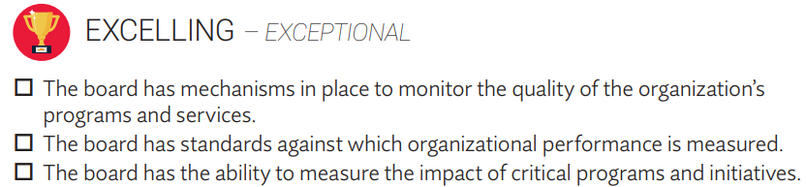
Notes:
The strategic plan, along with other data and resources shared by Cumberland’s staff should be used by your board regularly to review progress, monitor programs, and to assess how the work of the organization is meeting the community needs and in turn the organization’s mission. Boardsource offers a resource that helps your board with the monitoring and strengthening of programs
Share link to “Monitor and Strengthen” Handout
https://boardsource.org/wp-content/uploads/2017/01/Monitor-Strengthen-Tool.pdf?hsCtaTracking=f24fee92-8d38-414a-bfb1-8d393d06c709%7Cb43ea77c-6e29-4ed0-961c-77e94e1e0fb4

Slide 11
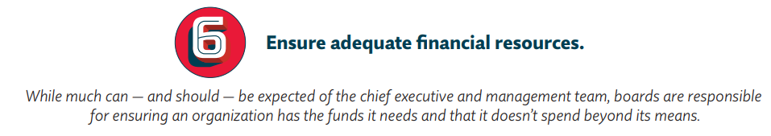
Time
Talent
Connections
Notes:
The next two responsibilities of your board are around financial oversight.
Boards of Directors ensure that the organizations have adequate financial resources in terms of their fund development goals and strategies. But more generally as a board member your time, talent, and connections are important to offer as a mechanism for ensuring adequate financial resources.
Your charge is to Ensure 100% board giving (time, talents, funds, etc) and Opens the doors to fundraising in the community; - your engagement and efforts go a long way in the success of the partnership for children.
If the board isn’t showing up to champion this great work in the community, why would others?
Connections
Talents
Time

Slide 12
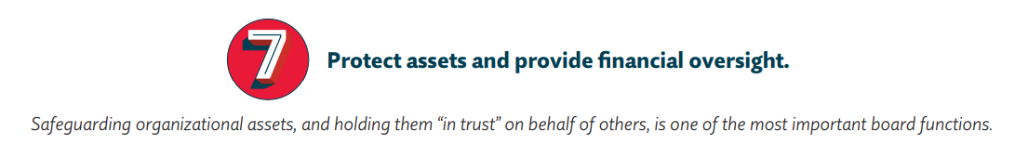



Notes:
Additionally, boards of directors are responsible for protecting financial assets and providing general financial oversite. The finance committee of the board is directly responsible for working with the organization’s staff to follow the finances of the organization and offer the board an overview. As a board member, your role is to draw the connection between the strategic plan and meeting the organizational mission and the financial health of the organization, which includes thoughtful stewardship of public and private funding.

Slide 13
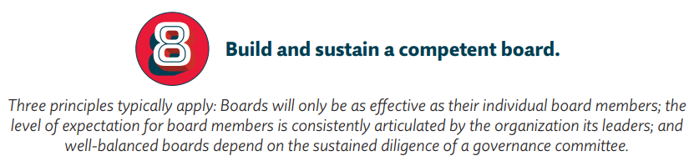

Notes:
I understand that your board of directors has an annual board recruitment plan led by the Board Governance Committee and there is a process for nomination of new Board members. It’s your responsibility for considering potential new board members and being really thoughtful about the needed diverse representation on the board—that includes race, age, gender, experience, regional representation, and expertise—with the goal of the board being reflective of the diversity of your community.
Boardsource offers a handout regarding the general best practices recruitment of board members, but of course follow your board governance committee’s guidance first.
Share Handout:
https://boardsource.org/wp-content/uploads/2019/08/Recruiting-Right-Board-Members-1.pdf?hsCtaTracking=0b0f62c8-594c-45cf-ab97-353a5578d62d%7C3870ba2e-3cf7-45d9-9ad1-a7a946cd6684

Slide 14
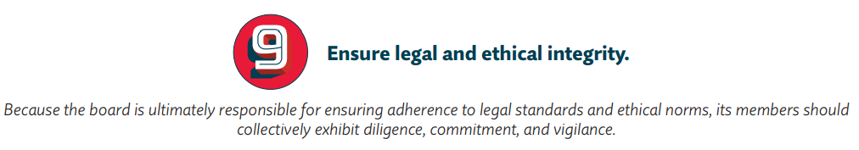
Achieve quorum when board action is needed.
Avoid conflicts of interest.
Adhere to Open Meetings and Public Record Law.
Smart Start funds cannot be used to influence legislation or carry on propaganda.
Notes:
Board members are also responsible for ensuring legal and ethical integrity for the organization. This includes things like achieving board quorum so that items that are voted on have sufficient board representation as well as avoiding conflicts of interest when making decisions. (ie: can’t vote by email) there are restrictions to be considered.
As a Smart Start board, responsible for the stewardship of public funds, there are a couple of unique requirements that are outlined in the Smart Start Legislation. Your board must adhere to open meetings and public records law, similar to other public bodies and governing boards. Additionally, because Smart Start funds are allocated through our state budget, they cannot be used to influence legislation. This means that Partnership for Children Cumberland County staff working on behalf of the organization are only allowed to educate public officials about the needs of the community and the important work that the organization and Smart Start does to meet those needs but cannot patriciate in lobbying activities or tell elected officials what action items to vote for specifically.

Slide 15
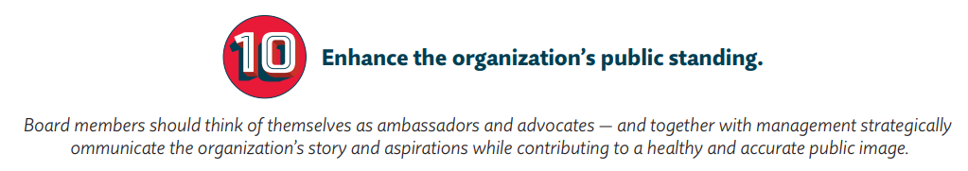
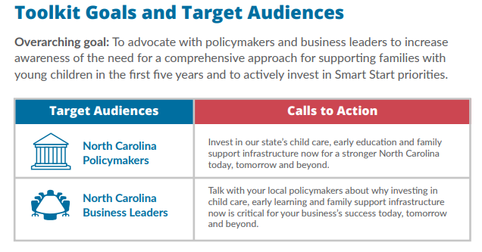

c
Smart Start Messaging Toolkit
Notes:
Finally, it is your role as a board member to be a strong public advocate and ambassador for . We have a newly developed Smart Start Messaging Toolkit that that offers talking points and strategies to help you communicate effectively about the important work of Partnership for Children Cumberland County and across the state. We’re going to share the link to that kit here and if you have questions about the use of the toolkit the staff at PFCCC can offer support.
Share link to Kit
https://ncsmartstart.sharepoint.com/:f:/g/lpcentral/EhTbMYBPQfFFvb48PlZuuGQBLJHlkyjQ4_z6q9JgIZ01Ow

Slide 16
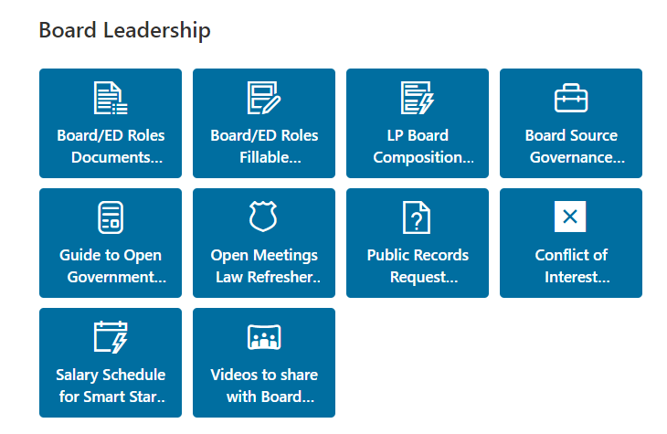
ED Orientation Resources Site
Notes:
As we end our time today, I want to be sure you know there are resources available for you in your role as a board member. You should have access to LP Central, which has these ED Orientation Resources site with these and many other resources from today.

Slide 17

Notes:
Once again, we are grateful to have had the opportunity to spend the time with you today and thank you for your time being here and working for this board.

