Slide 1
Grant Expectations and Requirements FY 2022-23
2
+
2
+
Serving Our Community Since 1993

Slide 2
We want to thank you!!
Thank you for all your hard work to assist with completing Formal Site Visit reports AND submitting your 4th Quarter and Year-End reports.
While not without challenges, we were all happy when the last button was pushed on the NCPC year-end report submissions.

Slide 3
Congratulations Family Connects!!
2
+
2
+
Family Connects started providing newborn home visits virtually in October 2021. PFC is partnering with Carolina Collaborative Community Care (4C) and Cape Fear Valley Regional Medical Center for babies from Cumberland, Hoke, and Robeson counties born at CFVRMC.

Slide 4
Quarterly Reports/Program Progress Reports (PPR) on time
Formal Site Visits (FSV) at least once during third quarter, sometimes more frequently.
Tell us about program modifications requiring a change to your activities, outcomes, or what you track (e.g., CAD, logic model, or GEMS modifications)
Changes to the point of contact / key personnel
Change in budget – Contact Marie Lilly and cc Pamela
Notes:
This photo by unknown author is licensed under CCBY-SA

Slide 5
Smart Start Grant Expectations and Requirements
Document for Review and Signature (DocuSign)
Contract Activity Description (CAD)
What you agreed to provide and measure for Smart Start. (Are changes needed?)
Logic Model
How do you know who to provide services to? (Established Need)
Who do you provide them to specifically? (Target population – has this changed since allocation?)
How do you track activities? (Outputs)
How do you track results? (Outcomes)
Notes:
Every single sentence in your CAD is what you have agreed to do. We expect you to hold this agreement and also provide documentation for each sentence when we monitor your program files.

Slide 6
Grant Expectations and Requirements
Contact Information Form (sent electronically)
Media Consent Form (sent electronically)
Dates for Reporting Outputs, Outcomes, and Program Progress Reports

Slide 7
Questions for Review
Grant Expectations and Requirements Questions
Programmatic Requirements – has the activity model been modified at the national, regional, or state level? If so, update model on file with PFC.
Reporting Outputs and Outcomes – has anything changed in the way you deliver services, or in your program activities?
Review CAD and Logic Model for changes. If you still need to consider a CAD change, please request a meeting with Pamela Federline for assistance.

Slide 8
Programmatic Requirements
Routine Manager Review - Review data entered against the Quality Assurance Report to assist with missing data and accuracy
Desktop Monitoring – Review of program implementation and data prior to NCPC report submission
Quarterly Reporting – Target Report/PPR review for accuracy before submission (GEMS users); Data review for non-GEMS users
Please let us know when GEMS quarterly Program Progress Reports (PPR) are completed (remember to hit SUBMIT).
After the quarterly reports have been submitted to P&E, DSP staff MUST notify our team prior to making changes to data in GEMS in the current or prior quarters. This is particularly important for prior quarter data already submitted to NCPC
Documentation – Submit in GEMS or send to your assigned QA Specialist; Submit all supporting files/data (i.e., Excel rather than .pdf files for data)
Formal Site Visit – We will begin this process earlier, and incorporate things we have learned and benefitted from last year’s process.

Slide 9
Outputs vs. Outcomes Samples
Outputs – Agreed on activities measured by Quarter

Slide 10
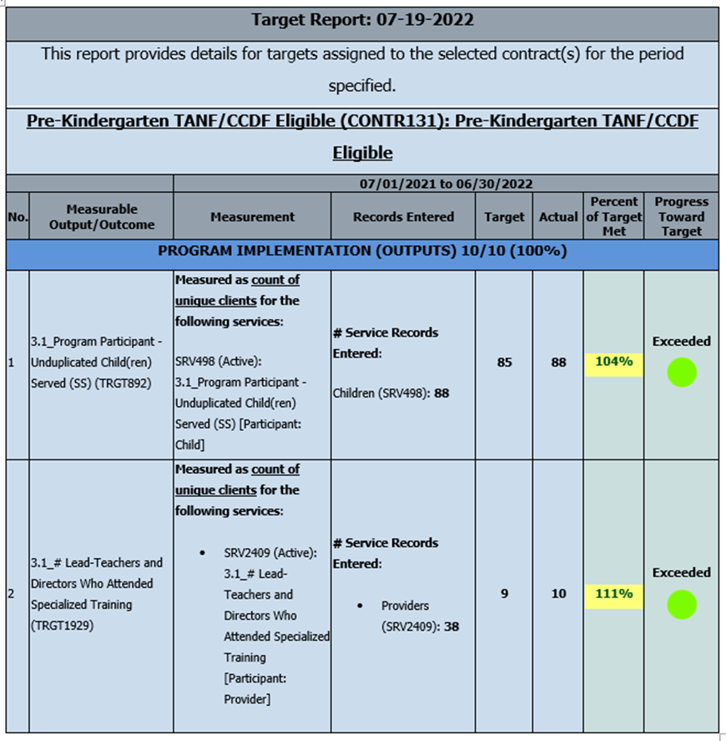
Quarterly Report

Slide 11
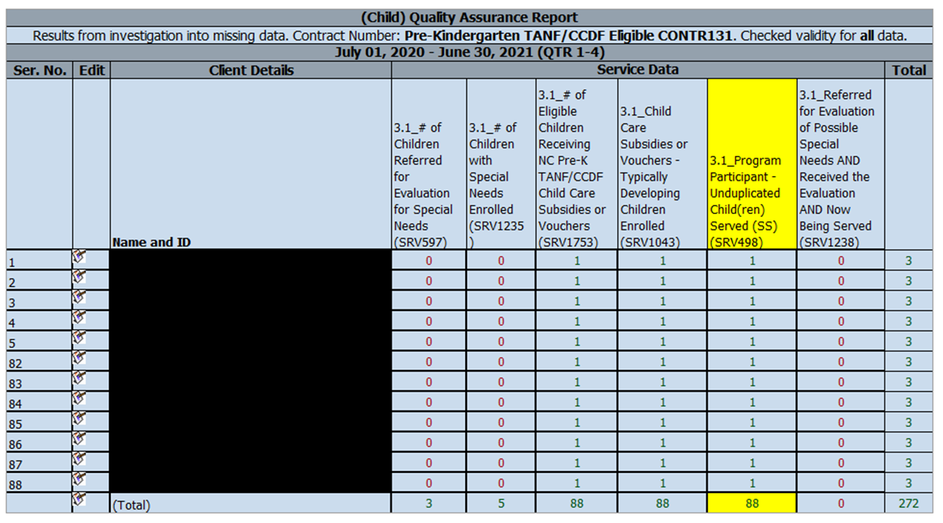
Quality Assurance Report Sample

Slide 12
Output Review
Notes:
Mapping the number of children funded to target and QA Report in GEMS

Slide 13
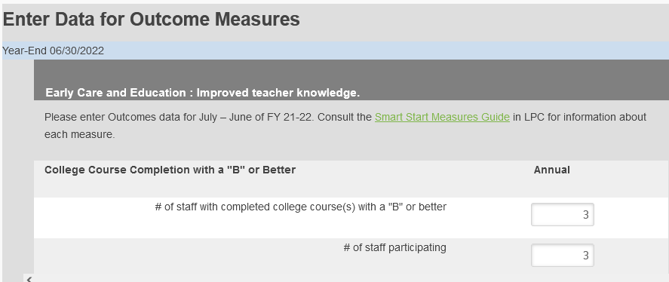
Outcome Sample

Slide 14
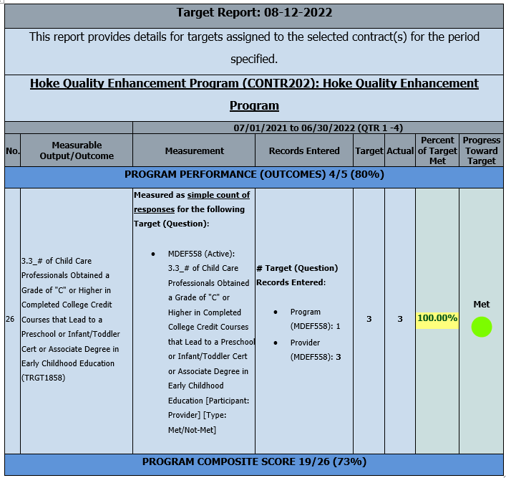
Outcome Sample (Target Report)

Slide 15
Outcome Sample (QA Report)

Slide 16
Outcome Sample (QA Report)

Slide 17
Documentation
GEMS & Non-GEMS users, please send all documentation via email to your assigned Quality Assurance Specialist.
Notes:
We are looking at possibly enhancing the format this year to be structured in a format that is organized by quarters. I will discuss this changes, if any during my personal/one=on=one meetings with each activity. Also I wanted to stress the importance of saving paper when submitting documents. We would prefer the submission of required documents into GEMS if you have access to minimize hard copies. I’ll be honest I don’t work out that much and carrying your folders around to formal site visits is a serious workout that I would like to avoid if possible. But if you need assistance with uploading documents into gems please feel free to reach out to me.

Slide 18
Formal Site Visit/Monitoring
Each activity from FY 2021-22 received the signed copy of the Formal Site Visit Monitoring Report. Quality Assurance Staff will be reaching out to you on follow-up items, which will be incorporated into Desktop Monitoring as applicable.
What to Plan for at your Site Visit:
Date selection options via Doodle poll and final selection by August 31st.
Advance questions will be sent for completion prior to the visit.
A percentage of service records and related documentation to be reviewed as applicable. Some programs may have 100% of records reviewed.
Discussion on successes and barriers to implementing your program.
Draft report sent to you for feedback and any missing documentation.
Final report sent to you for signature after updating.

Slide 19
Services and Support
Let us know what services your Quality Assurance staff can help you with to be successful in implementing your program/activity.
Ask for help before reports are due, including additional training in how to use GEMS if needed. We can provide 1:1 training for staff if needed.

Slide 20
Annual Impact Report
Your narratives and success stories are VERY important for both annual reporting and in telling the story of the work we all do through Impact Reports.
P&E will review everything submitted in the prior year and consider whether additional information is needed from a DSP. If additional information is needed, a request will be sent by September 30th and will be due by October 15th with your 1st Quarter report.

Slide 21
MOSAIC/GEMS Update
We worked with MOSAIC to create internal Subsidy reports that can be used by Fiscal and P&E to better manage balancing and reporting.
Our next anticipated project is to update the PPR, which will include an opportunity for feedback by users.
We hope to create an Early Childhood Datamart where diverse data reports can be pulled in and mapped to help us track services and clients across programs.
We will be adding a data entry screen for Kaleidoscope.

Slide 22
2
+
2
+

Slide 23
First quarter reports will be due in 90 days 60 days!

Slide 24
Thank You
For more information, contact any of the P&E Team:
Pamela Federline - pfederline@ccpfc.org
Heather Gallagher – hgallagher@ccpfc.org
Lydia Wiles - lwiles@ccpfc.org
Visit the DSP Portal on the Partnership’s Website:
https://ccpfc.org/partners/dsp/
For Fiscal Support, please contact:
Marie Lilly – mlilly@ccpfc.org
Dottie Adams – dadams@ccpfc.org

